Slide 1
Chapter 11: Basic I/O Interface

Slide 2
11–3 THE PROGRAMMABLE PERIPHERAL
82C55 programmable peripheral interface (PPI) is a popular, low-cost interface component found in many applications.
The PPI has 24 pins for I/O, programmable in groups of 12 pins and groups that operate in three distinct modes of operation.

Slide 3
The 82C55 (CMOS version) requires wait states if operated with a processor using higher than an 8 MHz clock.
Because I/O devices are inherently slow, wait states used during I/O transfers do not impact significantly upon the speed of the system.
The 82C55 still finds application even in the latest Core2-based computer system.

Slide 4
82C55 is used for interface to the keyboard and parallel printer port in many PCs.
found as a function within an interfacing chip set
also controls the timer and reads data from the keyboard interface
An experimentation board is available that plugs into the parallel port of a PC, to allow access to an 8255 located on the board.
The 8255 is programmed in either assembly language or Visual C++ through drivers available with the board.

Slide 5
Basic Description of the 82C55
Fig 11–18 shows pin-outs of the 82C55 in DIP and surface mount (flat pack) format.
The three I/O ports (labeled A, B, and C) are programmed as groups.
group A connections consist of port A (PA₇–PA₀) and the upper half of port C (PC₇–PC₄)
group B consists of port B (PB₇–PB₀) and the lower half of port C (PC₃–PC₀)
82C55 is selected by its CS pin for programming and reading/writing to a port.

Slide 6
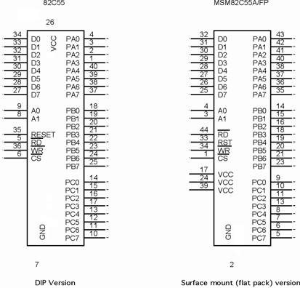
Figure 11–18 The pin-out of the 82C55 peripheral interface adapter (PPI).

Slide 7
Programming the 82C55
82C55 is programmed through two internal command registers shown in Figure 11–20.
Bit position 7 selects either command byte A or command byte B.
command byte A programs functions of group A and B
byte B sets (1) or resets (0) bits of port C only if the 82C55 is programmed in mode 1 or 2
Group B (port B and the lower part of port C) are programmed as input or output pins.

Slide 8
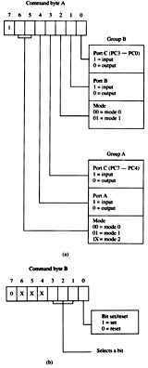
Figure 11–20 The command byte of the command register in the 82C55. (a) Programs ports A, B, and C. (b) Sets or resets the bit indicated in the select a bit field.
group B operates in mode 0 or mode 1
Mode 0 is basic input/output mode that allows the pins of group B to be programmed as simple input and latched output connections
Mode 1 operation is the strobed operation for group B connections
data are transferred through port B
handshaking signals are provided by port C

Slide 9
Group A (port A and the upper part of port C) are programmed as input or output pins.
Group A can operate in modes 0, 1, and 2.
mode 2 operation is a bidirectional mode of operation for port A
If a 0 is placed in bit position 7 of the command byte, command byte B is selected
This allows any bit of port C to be set (1) or reset (0), if the 82C55 is operated in either mode 1 or 2.
otherwise, this byte is not used for programming

Slide 10
An LCD Display Interfaced to the 82C55
LCDs (liquid crystal displays) have replaced LED displays in many applications.
Fig 11–22 shows an Optrex DMC-20481 LCD display interfaced to an 82C55.
DMC-20481 is a 4-line by 20-characters-per-line display that accepts ASCII code as input data
It also accepts commands that initialize it and control its application.

Slide 11
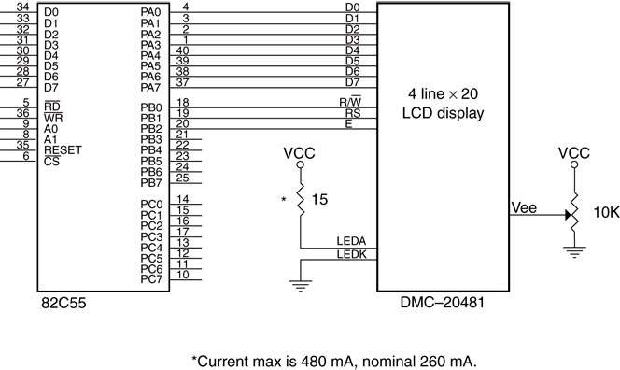
Figure 11–22 The DMC-20481 LCD display interfaced to the 82C55.

Slide 12
The data connections, which are attached to the 82C55 port A, are used to input display data and to read information from the display.
For a 4-bit interface, D₄–D₇ pins are used where the data must be formatted with the high nibble first, followed by the low nibble.
A few newer OLED devices contain a serial interface that uses a single pin for the data.

Slide 13
After initialization, time delays are no longer needed when sending data or many commands to the display.
The clear display command still needs a time delay as the busy flag is not used .
Instead of a time delay, the busy flag is tested to see whether the display has completed an operation.
The BUSY procedure tests the LCD display and only returns when the display has completed a prior instruction.

Slide 14
Once the BUSY procedure is available, data can be sent to the display by writing another procedure called WRITE.
The WRITE procedure uses BUSY to test before trying to write new data to the display.
the WRITE procedure, which transfers the ASCII character from the BL register to the current cursor position of the display.

Slide 15
The only other procedure needed for a basic display is the clear & home cursor procedure, called CLS
This procedure uses the SEND macro from the initialization software to send the clear command to the display.
With CLS and the procedures presented thus far, you can display any message on the display, clear it, display another message, and basically operate the display.

Slide 16
Key Matrix Interface
Keyboards come in a variety of sizes, from standard 101-key QWERTY keyboards to special keyboards that contain 4 to 16 keys.
Fig 11–25 is a key matrix with 16 switches interfaced to ports A and B of an 82C55.
the switches are formed into a 4 × 4 matrix, but any matrix could be used, such as a 2 × 8
The keys are organized into four rows and columns: (ROW₀–ROW₃) (COL₀–COL₃)

Slide 17
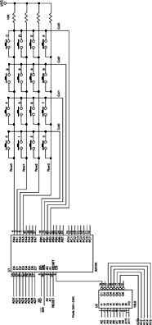
Figure 11–25 A 4 × 4 keyboard matrix connected to an 8088 microprocessor through the 82C55 PIA.
the 82C55 is decoded at I/O ports 50H–53H for an 8088
port A is programmed as an input port to read the rows
port B is programmed as an output port to select a column
a flowchart of the software required to read a key from the keyboard matrix and debounce the key is illustrated in Fig 11–26

Slide 18
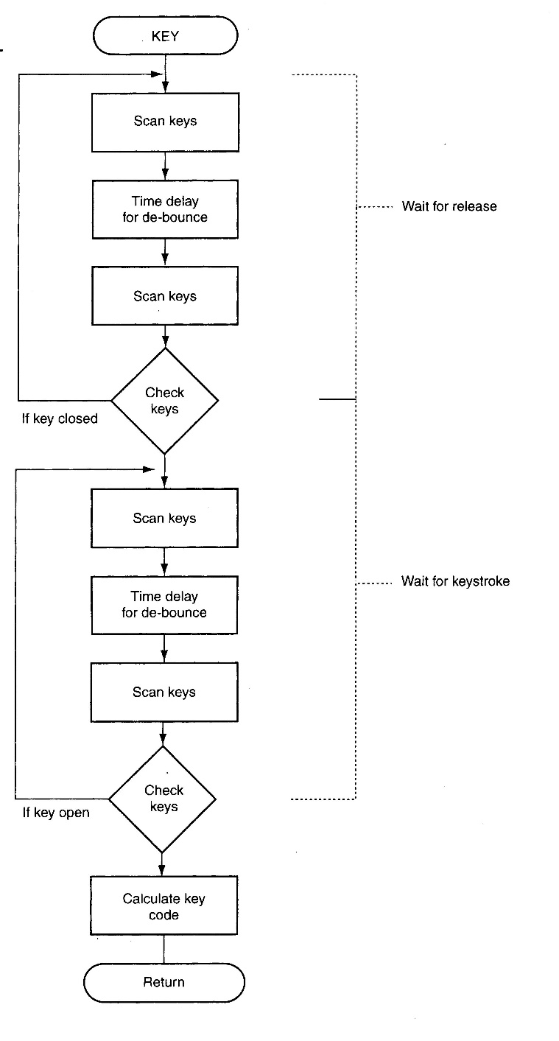
Figure 11–26 The flowchart of a keyboard-scanning procedure.
keys must be debounced, normally with a time delay of 10–20 ms
the software uses a procedure called SCAN to scan the keys and another called DELAY10 to waste 10 ms of time for debouncing
the main keyboard procedure is called KEY and appears in Example 11–17
the KEY procedure is generic, and can handle any configuration from a 1 × 1 matrix to an 8 × 8 matrix.

